Slide 1
THE PRICE
OF PREMIUM
An Analysis of Hospital Markups and Quality

Slide 2
Table of Contents
01
02
03
05
The Central
Question
The Surprising
Answer
04
The Real
Drivers
The “Value”
Tradeoff
Conclusion &
Dashboard

Slide 3
01
The Central Questions

Slide 4

Key Questions:
Are hospitals with higher costs, charges, and/or markups more likely to achieve lower readmission and mortality rates?
Are hospital size and type related to the costs and quality outcomes?
How do patient satisfaction scores relate to financial measures, hospital categories, and clinical quality metrics?

Slide 5
Definitions
Costs | What the hospital pays for services
Charges | What the patient is billed for services
Markup Percentage | How many dollars a hospital charges for every $1 of cost
Quality Metrics | Mortality, Readmission, and Patient Satisfaction (Hospital Rating, 0-100)

Slide 6
02
The Surprising Answers

Slide 7
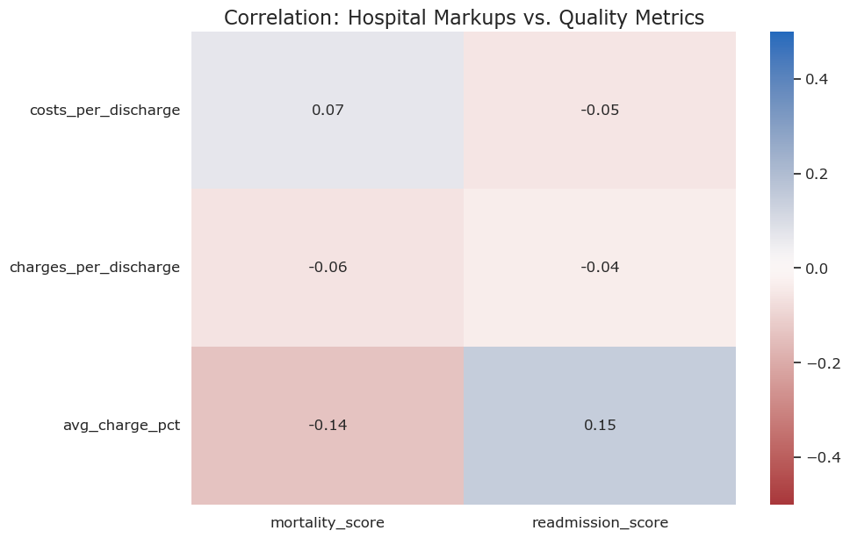
Price is Decoupled from Clinical Safety
Correlation between charge markup percentage and mortality is a negligible −0.14.
Correlation between charge markup percentage and readmissions is a similar 0.15.
Costs and charges show almost no correlation to mortality or readmissions.

Slide 8
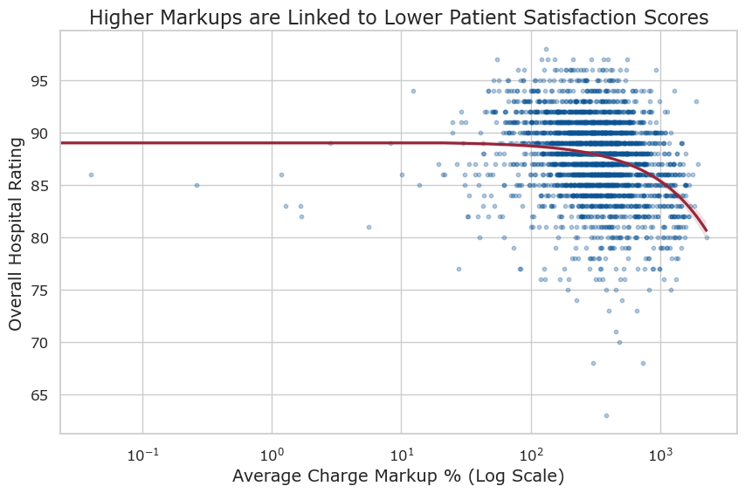
High Markups are Linked to Poor Patient Experience
Higher markups are more closely related to worse patient satisfaction scores. This is especially true of doctor communication and discharge information with -0.38 and -0.36 correlation to charge markup percentages, respectively.
Costs per discharge have some correlation with higher patient ratings while charges per discharge have only a slight correlation.

Slide 9
03
The Real Drivers

Slide 10
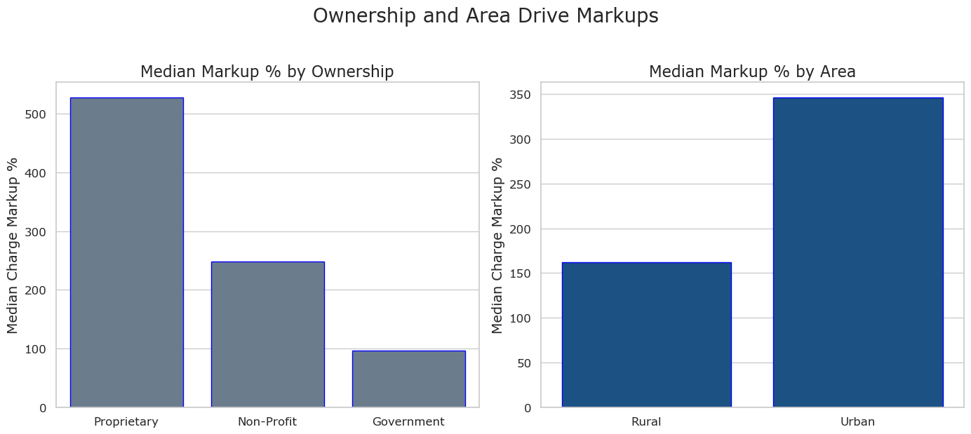
The Drivers of Price: Ownership and Cost Management
The evidence:
Here’s an assortment of alternative resources whose style fits that of this template:
Hand drawn doctor in hospital background
Flat-hand drawn hospital reception scene

Slide 11
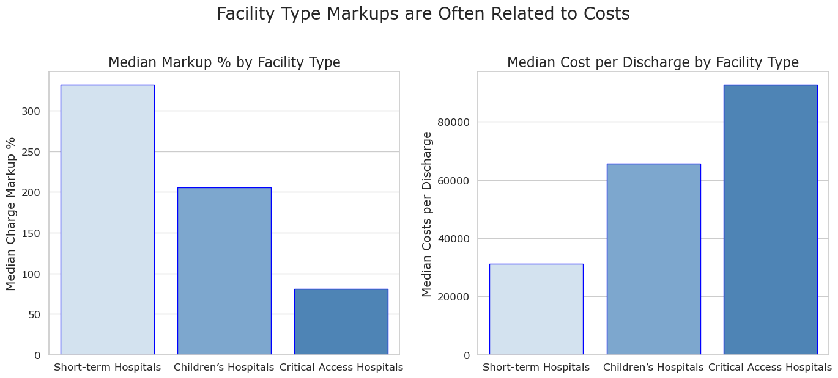
The Drivers of Price (continued)
The evidence:
Here’s an assortment of alternative resources whose style fits that of this template:
Hand drawn doctor in hospital background
Flat-hand drawn hospital reception scene

Slide 12
04
The “Value”
Tradeoff

Slide 13
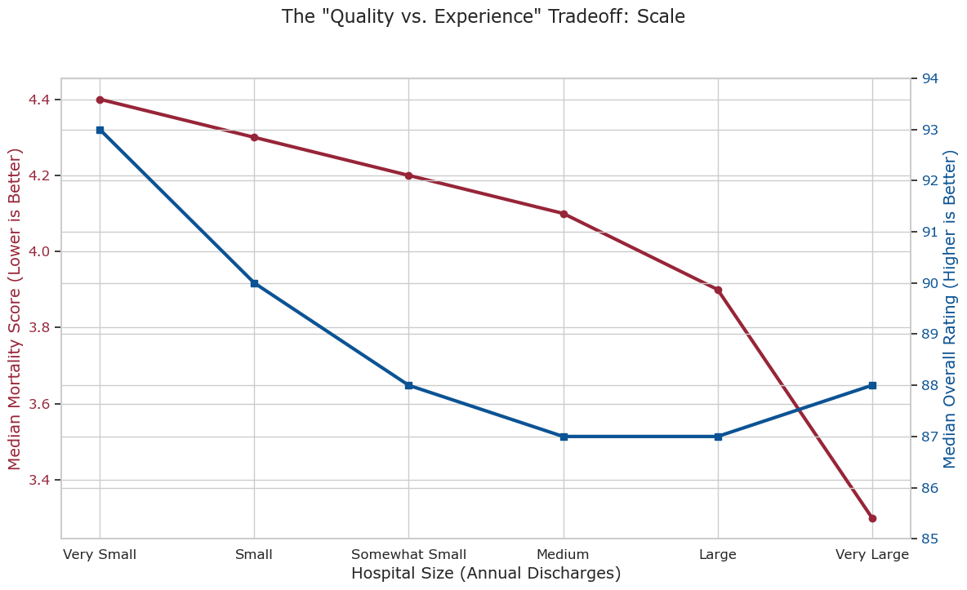
The Driver of Quality is Scale
There is some tradeoff between clinical safety and patient experience. Mortality rates are best at the largest hospitals (50,000+ discharges), but patient ratings peak at smaller hospitals.

Slide 14

Conclusion

Slide 15
The Proof: What Actually Predicts a Hospital's Markup?
For-Profit Status | +448 markup points (p < 0.001)
Urban Environment | +60 markup points (p < 0.001)
Hospital Size | +43 markup points for every 10k annual discharges (p < 0.001)
Worse Readmission Score | +32 markup points (p < 0.001)
Better Patient Rating | -8 markup points (p < 0.001)
Clinical Mortality Score | No significant impact (p = 0.457)

Slide 16
Conclusion
Takeaways:
Price is a Business Decision, Not a Quality Signal: Price is unrelated to clinical safety and negatively tied to patient experience.
Ownership & Cost Drive Markups: For-profit status and lower urban cost-structures are the primary drivers of high markups.
The Real Tradeoff is Scale vs. Experience: Patients must choose between the clinical safety of large hospitals and the patient experience of small ones.
Recommendations:
Favor non-profit hospitals for value.
Favor large scale hospitals for complex and life-saving care.

Slide 17
Thank You!
QUESTIONS?
jaques.kyle@gmail.com
https://linkedin.com/in/kyle-jaques
Public Dashboard:
https://public.tableau.com/app/profile/kyle.jaques/viz/ThePriceofPremiumDashboard/ThePriceofPremium
All datasets used for analysis are from the Centers for Medicare and Medicaid Services.

